Slide 1



Trusted sla-guided data integration on multi-cloud environments
Daniel Aguiar da Silva Carvalho, Magellan, IAE, Université Jean Moulin Lyon3
Advisors
Chirine Ghedira Guegan, Magellan, IAE, Université Jean Moulin Lyon3
Genoveva Vargas-Solar, CNRS, LIG-LAFMIA, France
Nadia Benani, CNRS INSA-Lyon, LIRIS, UMR5205 - France

Slide 2
Data integration: existing work
Query
Result
Data integration: the teenage years. Halevy, A., Rajaraman, A., & Ordille, J. (VLDB 2006, September)
Schema integration: Past, present, and future (Ram, S., & Ramesh, V. 1999)
Global schema
Mediator
Query rewriting
Data integration architectures:
Multi-databases, federations, DW, …
(Domenig & Dittrich 1999 Sigmod Record)
MiniCon algorithm for query rewriting (Pottinger and Halevy, 2001)
Exported schemata
Data
source A
Data
source B
Data
source C
Heterogeneous data sources known in advance

Slide 3
Data integration: existing work
Services lookup and matching
[1] Paolucci, M., Kawamura, T., Payne, T. R., & Sycara, K. (2002, June). Semantic matching of web services capabilities. In International Semantic Web Conference (pp. 333-347). Springer Berlin Heidelberg.
[2} Bramantoro, A., Krishnaswamy, S., & Indrawan, M. (2005, November). A semantic distance measure for matching web services. In International Conference on Web Information Systems Engineering (pp. 217-226). Springer Berlin Heidelberg.
[3} APA Maximilien, E. M., & Singh, M. P. (2004, November). Toward autonomic web services trust and selection. In Proceedings of the 2nd international conference on Service oriented computing (pp. 212-221). ACM.
Query
Result
Mediator
Query rewriting techniques adapted to service composition
Exported API
[4] Barhamgi, M., Benslimane, D., and Medjahed, B. (2010). A query rewriting approach for web service composition. IEEE T. Services Computing, 3(3):206–222.
[5] da Costa, U. S., Alves, M. H. F., Musicante, M. A., and Robert, S. (2013). Automatic refinement of service compositions. In Daniel, F., Dolog, P., and Li, Q., editors, ICWE, volume 7977 of Lecture Notes in Com- puter Science, pages 400–407. Springer.
[6] Zhao, W., Liu, C., and Chen, J. (2011). Automatic composition of information-providing web services based on query rewriting. Science China Information Sciences, pages 1–17.
. . .
Distributed data services

Slide 4
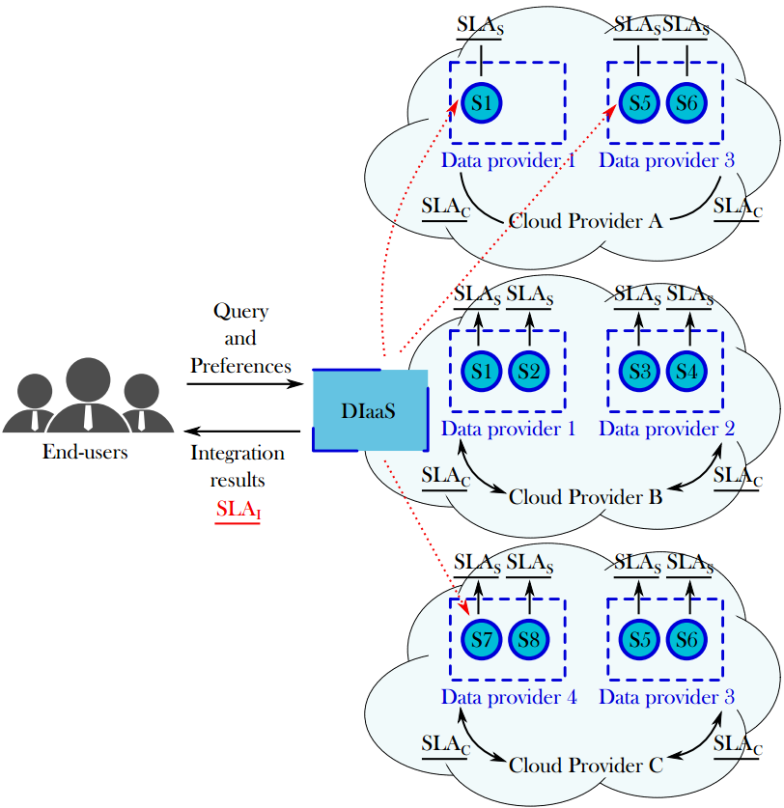
Challenges
Which services should I select ? Are the requirements being respected?
How to be sure that all SLAs are being respected?
How to integrate different SLAs associated to services involved with user’s requirements?
How results can be reused for a next query?

Slide 5
Which services should I select ? Are the requirements being respected?
How to be sure that all SLAs are being respected?
How to integrate different SLAs associated to services involved with user’s requirements?
How results can be reused for a next query?
Objective
Propose a data integration solution in a multi-cloud environment guided by user requirements and SLA exported by different clouds

Slide 6
Main contributions
Systematic mapping¹
build the corpus of the state of the art and identify new trends and open issues around our research topic.
Rhone, query rewriting algorithm² for data integration
Considers user integration preferences and services’ quality aspects expressed in SLAs.
¹ D. A. S. Carvalho, P. A. Souza Neto, G. Vargas-Solar, N. Bennani, C. Ghedira, Can Data Integration Quality be Enhanced on Multi-cloud using SLA?, In 26th Int. Conf. on Database and Expert Systems Applications, Spain, 2015.
² D. A. S. Carvalho, P. A. S. Neto, C. Ghedira, G. Vargas-Solar, N. Bennani. Rhone: a quality-based query rewriting algorithm for data integration. East-European Conference on Advances in Databases and Information Systems, Aug 2016, Prague, France. ADBIS East-European Conference on Advances in Databases and Information Systems, 2016.

Slide 7
Approach
Address data integration considering
data quality (freshness, provenance, cost, availability) properties &
service level agreements (SLA)
Hypothesis
the data integration process is totally or partially externalized on different clouds that provide necessary resources under different conditions (SLA)
data can be retrieved from several data providers (i.e., services) with different quality properties
Notes:
In orther to achieve our objective we propose to address data integration considering data quality (freshness, provenance, cost, availability) properties and service level agreements (SLA)
Assuming two important hypotesis:
First, the data integration process is totally or partially externalized on different clouds that provide necessary resources under different conditions (SLA)
and second data can be retrieved from several data providers (i.e., services) with different quality properties

Slide 8
Rhone Service-Based Query Rewriting Algorithm
Selecting candidate concrete services
Creating candidate service descriptions (CSD)
Combinig CSDs
Producing rewritings
A rewriting algorithm customizing
data providers (services) look up
data integration considering different data consumers requirements and expectations
requirements & expectations depend on the context in which they consume data (e.g., mobile devices with few physical capacities, critical decision making)
Notes:
We have proposed and designed a service-based query rewriting algorithm taking into account our approach and hypotesis.
It consists in 4 steps: including service matching and service combination ensuring that they fulfill quality requirements.
Our algorithm customizes:
The data providers services look up. The data integration considering different data consumers requirements and expectations
And the requirements and expectations depend on the context in which they consume data (e.g., mobile devices with few physical capacities, critical decision making)
In the following I briefly describe the general principle of the steps.

Slide 9
Rhone Service-Based Query Rewriting Algorithm
Abstract services
Concrete services
Query
Selecting candidate concrete services
Creating candidate service descriptions (CSD)
Combinig CSDs
Producing rewritings
Services are selected considering their characteristics (expressed in the SLAs)
Services that can produce results that are useless to the user query are discarded in the first step
Notes:
Given a set of abstract services, a set of concrete services and a query defined by the user as inputs
In the first step candidate concrete services are selected.
These services are selected considering their characteristics (expressed in the SLAs) and services that can produce results that are useless to the user query are discarded in the first step.

Slide 10
Rhone Service-Based Query Rewriting Algorithm
Abstract services
Concrete services
Query
Selecting candidate concrete services
Creating candidate service descriptions (CSD)
Combinig CSDs
Producing rewritings
Differently from the other algorithms, the mapping are created considering the concrete service definition and not each abstract service that compose it
Notes:
In the second step, the Rhone tries to build mapping from each concrete service to the query (These mapping are represented in a data structure that we call CSD).
Differently from the other algorithms, the mapping are created considering the concrete service definition and not each abstract service that compose it. This fact reduces the number of combination produced in the next step.

Slide 11
Rhone Service-Based Query Rewriting Algorithm
Abstract services
Concrete services
Query
Selecting candidate concrete services
Creating candidate service descriptions (CSD)
Combinig CSDs
Producing rewritings
Combinations are produced according to the part of the query that a given concrete service covers like the combinations in the Bucket algorithm
Notes:
In the third step,
The CSDs created are combined among them. Combinations are produced according to the part of the query that a given concrete service covers like the combinations in the Bucket algorithm.
This is the most expensive step in the algorithm depending on the size of the query and the number of CSDs

Slide 12
Rhone Service-Based Query Rewriting Algorithm
Abstract services
Concrete services
Query
Selecting candidate concrete services
Creating candidate service descriptions (CSD)
Combinig CSDs
Producing rewritings
Differently from the other approaches, the rewritings are produced considering the user preferences and constraints, and the SLAs exported by the different data services.
Notes:
The last step ‘producing rewriting’ in which we have to check if the combination produced is a valid rewriting or not.
Click

Slide 13
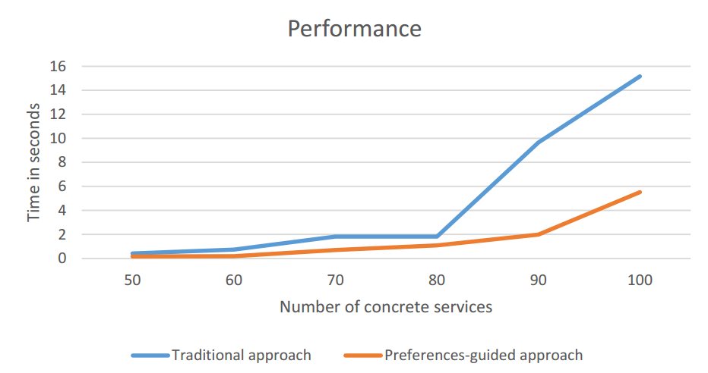
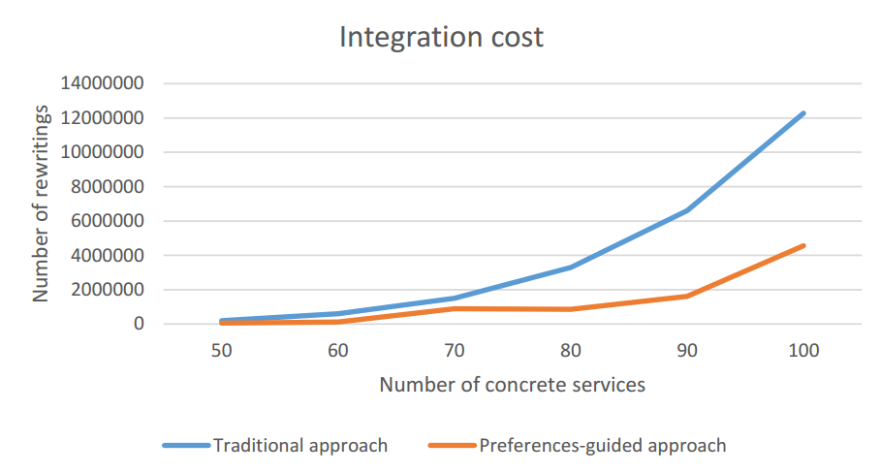
Experimentation: Lessons learned
Complexity
Selecting candidate concrete services: O (n²)
Creating candidate service descriptions: O (n³)
Combining CSDs: O (n^{k})^{m}
Producing rewritings: O (n)
Performance increased reducing
The number of rewriting solutions
Integration execution time
Rewriting solutions quality enhanced
Integration economic cost potentially reduced
Notes:
Based on the experimental validation, we can show you the Rhones’ profile
We can see the complexity of the different phases. As in the other algorithms, the most expensive step is the combination. It depends on the size of the query and the number of concrete service that could be mapped to the query.
The results of our experimental validation are illustrated by these two charts.
The performance increased by reducing the number of rewriting solutions and integration execution time. As we can see in the chart on the left.
Rewritring solutions quality enhanced and the integration economic cost is reduced once only rewriting that satisfies the user preferences are produced. As we can see in the chart on the right.
Click

Slide 14
Ongoing work
Data integration metamodel¹: a metaprocess and process for data integration adapted to the multi-cloud context
Cloud SLA, service SLA and integration SLA models
Reduce overhead caused by quey rewriting
Taxonomy of query variations for promoting the reusability of rewriting results
Heuristics for optmizing the rewriting approach adapted to the multi-cloud context
Evaluation of the overall data integration approach adapted to the multi-cloud context
¹ D. A. S. Carvalho, P. A. S. Neto, C. Ghedira, G. Vargas-Solar, N. Bennani. Towards Quality Guided Data Integration on Multi-Cloud Settings. 14th international conference on service oriented computing (ICSOC), Oct 2016, Banff, Alberta, Canada.

Slide 15
Daniel Aguiar da Silva Carvalho, Magellan, IAE, Université Jean Moulin Lyon3
Advisors:
Chirine Ghedira Guegan, Magellan, IAE, Université Jean Moulin Lyon3
Genoveva Vargas-Solar, CNRS, LIG-LAFMIA, France
Nadia Benani, CNRS INSA-Lyon, LIRIS, UMR5205 - France

Slide 16
Systematic mapping
Build the corpus of the state of the art and identify new trends and open issues around our research topic.
Database | Amount | Included | Excluded
IEEE | 658 | 56 | 602
ACM | 649 | 31 | 618
Science Direct | 106 | 6 | 100
CiteSeerX | 419 | 21 | 398
Total | 1832 | 114 | 1718
D. A. S. Carvalho, P. A. Souza Neto, G. Vargas-Solar, N. Bennani, C. Ghedira, Can Data Integration Quality be Enhanced on Multi-cloud using SLA?, In 26th Int. Conf. on Database and Expert Systems Applications, Spain, 2015.

Slide 17
Rhone query rewriting algorithm
Query rewriting algorithm for data integration that considers user integration preferences and services’ quality aspects expressed in SLAs.
D. A. S. Carvalho, P. A. S. Neto, C. Ghedira, G. Vargas-Solar, N. Bennani. Rhone: a quality-based query rewriting algorithm for data integration. East-European Conference on Advances in Databases and Information Systems, Aug 2016, Prague, France. ADBIS East-European Conference on Advances in Databases and Information Systems, 2016.

Slide 18
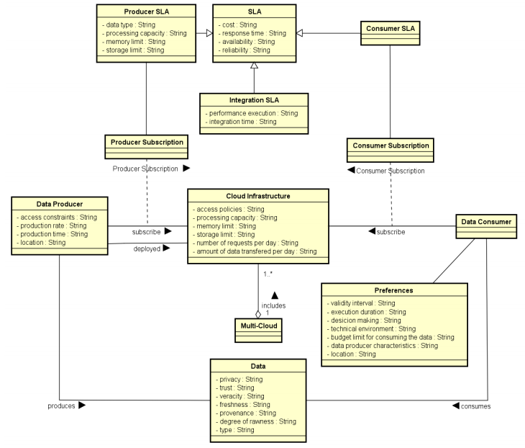

Data integration metamodel
A metaprocess and process for data integration adapted to the multi-cloud context
D. A. S. Carvalho, P. A. S. Neto, C. Ghedira, G. Vargas-Solar, N. Bennani. Towards Quality Guided Data Integration on Multi-Cloud Settings. 14th international conference on service oriented computing (ICSOC), Oct 2016, Banff, Alberta, Canada.

Slide 19
Future work
Refinement of the SLA schemas
Apply and evaluate the heuristics to the rewriting approach
Design of a architecture which allows data providers to manipulate and configure the necessary resources to their services
Evaluation of the overall data integration approach adapted to the multi-cloud context

